Slide 1

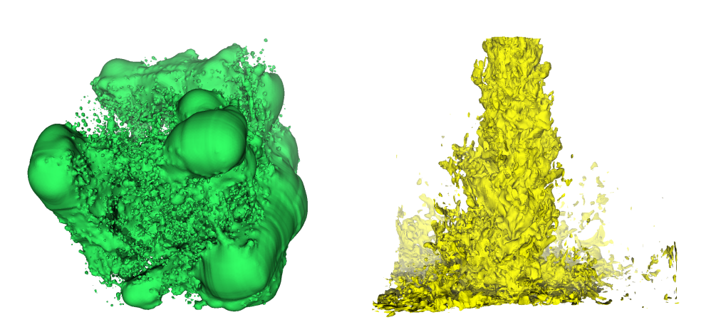
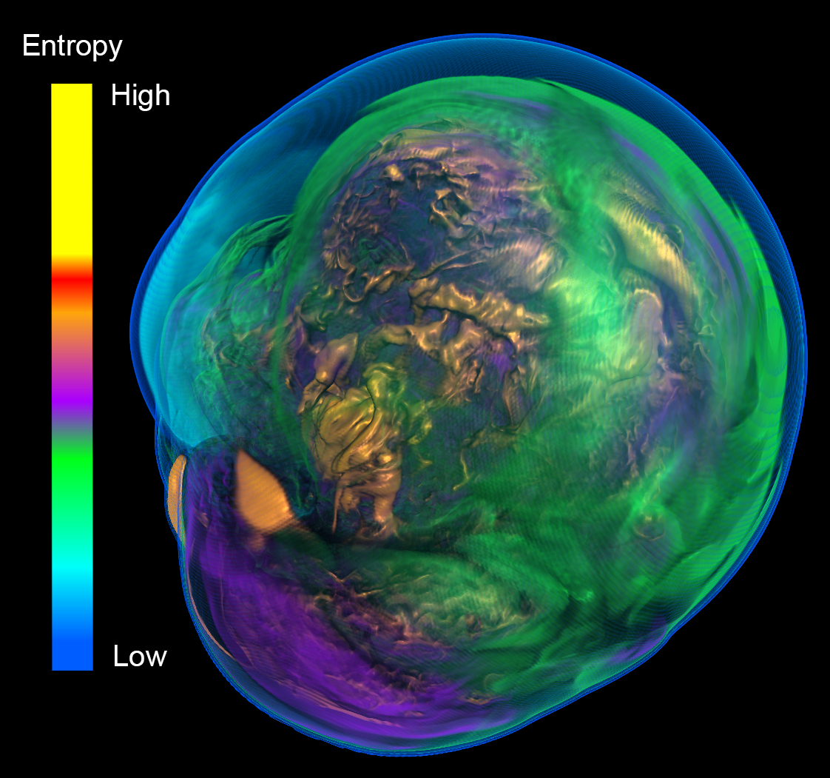
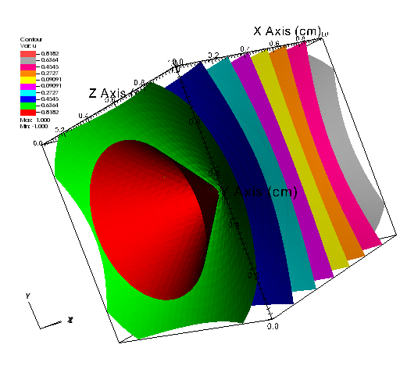
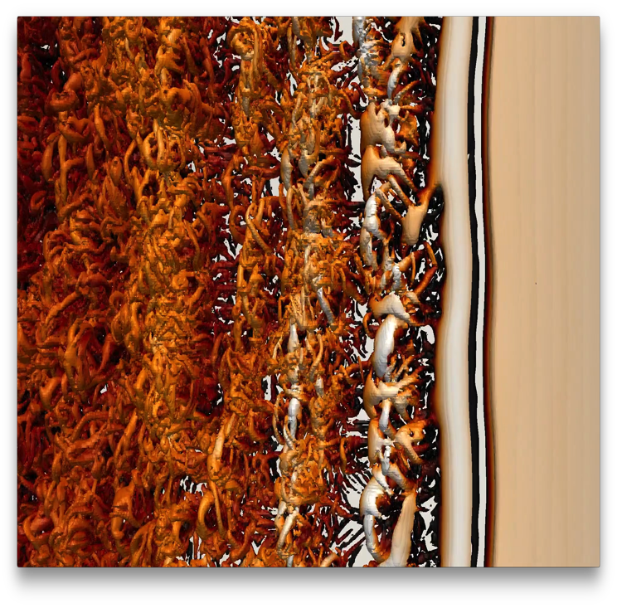
VTK-m: Visualization on Modern Processors
Kenneth Moreland Sandia National Laboratories
November 15, 2017

Slide 2


Acknowledgements
This material is based upon work supported by the U.S. Department of Energy, Office of Science, Office of Advanced Scientific Computing Research, under Award Numbers 10-014707, 12-015215, and 14-017566.
This research was supported by the Exascale Computing Project (17-SC-20-SC), a collaborative effort of two U.S. Department of Energy organizations (Office of Science and the National Nuclear Security Administration) responsible for the planning and preparation of a capable exascale ecosystem, including software, applications, hardware, advanced system engineering, and early testbed platforms, in support of the nation’s exascale computing imperative.
Sandia National Laboratories is a multimission laboratory managed and operated by National Technology and Engineering Solutions of Sandia, LLC., a wholly owned subsidiary of Honeywell International, Inc., for the U.S. Department of Energy’s National Nuclear Security Administration under contract DE-NA-0003525.
Thanks to many, many partners in labs, universities, and industry.

Slide 3
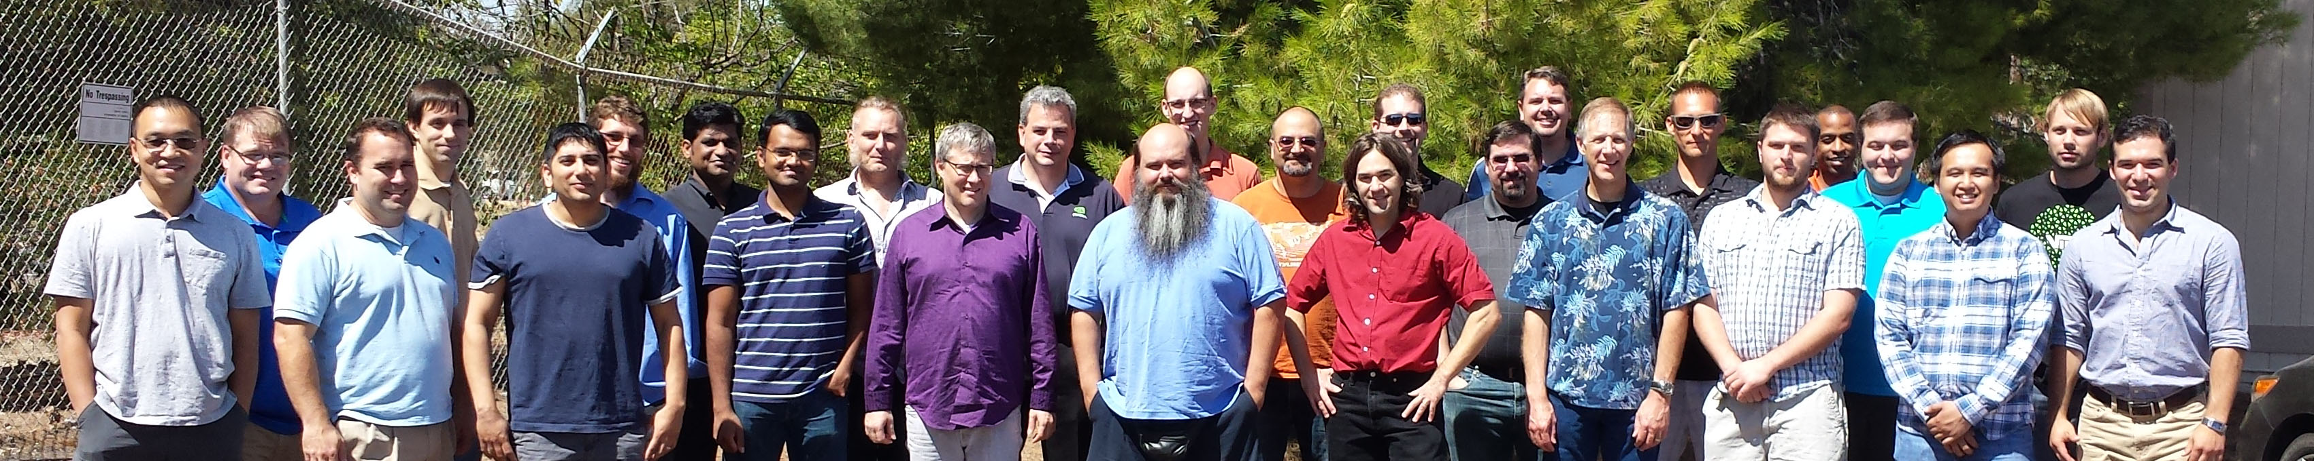
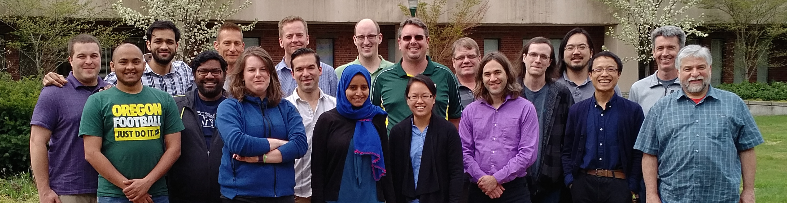
Thanks to All Our Partners!
Code Sprint, September 2015, LLNL
Code Sprint, April 2017, University of Oregon

Slide 4
Why VTK-m?

Slide 5
My new computer's got the clocks, it rocks
But it was obsolete before I opened the box
− “Weird” Al Yankovic, It’s All About the Pentiums, circa 1999
Moore’s Law is dead.
− Gordon Moore, circa 2005
Notes:
Why is this happening now?
In previous years we enjoyed a doubling of clock rate every 18 months
Frustrating to computer buyers but great for HPC
(Technically, it’s Dennard scaling, that power in transistors drops as they shrink, that is dead.)
Now, clock rates have leveled off at 2-4 GHz
Manufactures compensate by adding more cores, more parallelism

Slide 6
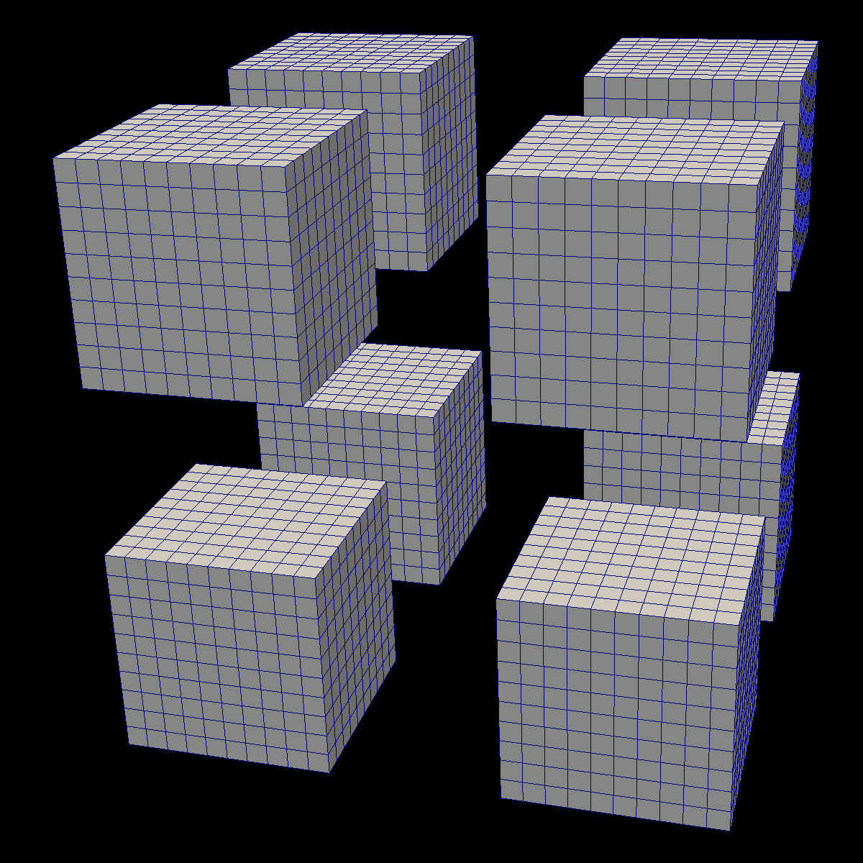
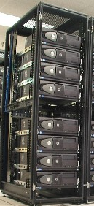


Distributed
Parallelism
DIY

Slide 7
Distributed
Parallelism
DIY
On Node
Parallelism

Slide 8

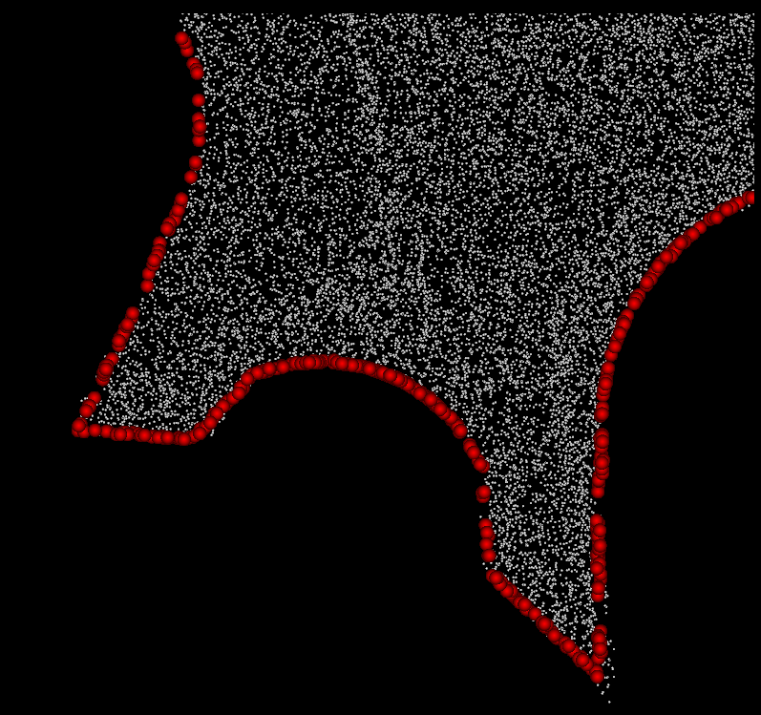
VTK-m is separate from VTK
Algorithm
Simulation

Slide 9

VTK-m is not a replacement for VTK
Algorithm
Filter
Simulation

Slide 10
Reader
Filter
Algorithm
Filter
Simulation
Filter
Rendering

Slide 11
How Do I Use VTK-m?

Slide 12
How Do I Use VTK-m?
I use tools like ParaView, Catalyst, etc.
I develop software that uses (or will use) visualization libraries.
I develop visualization software and want to make the leap to many-core devices.

Slide 13
How Do I Use VTK-m?
I use tools like ParaView, Catalyst, etc.

Slide 14
Reader
Filter
Algorithm
Filter
Simulation
Filter
Rendering

Slide 15
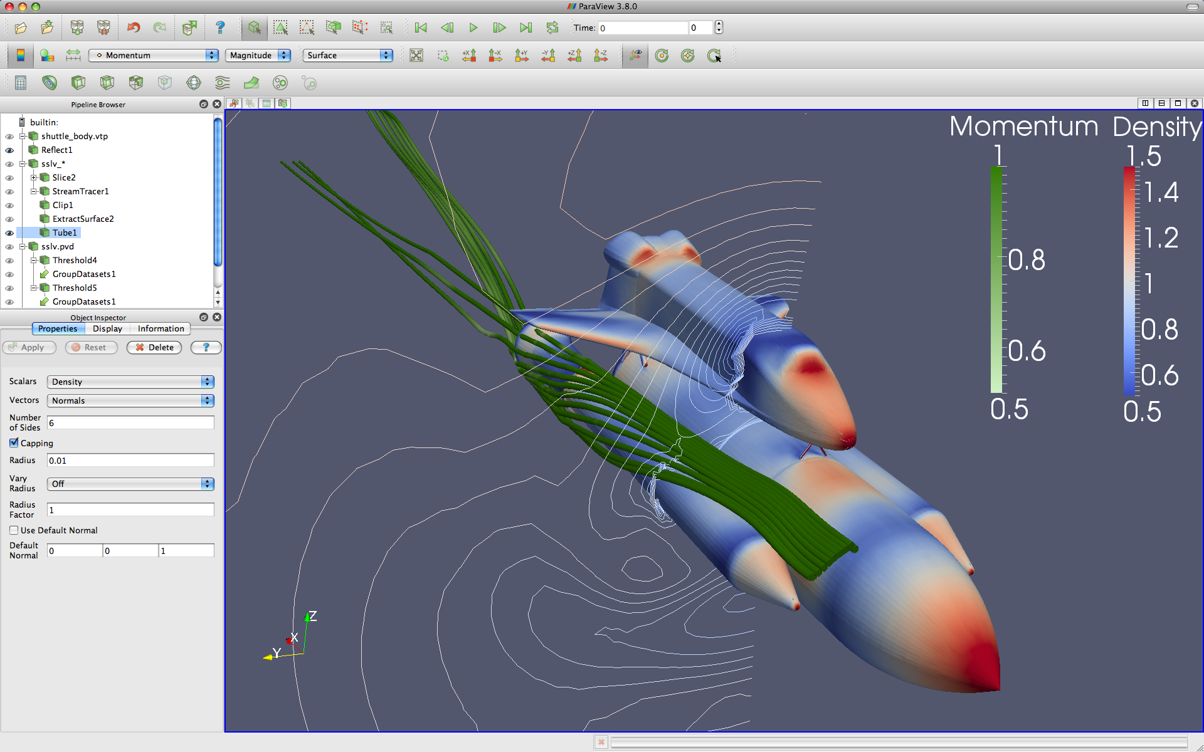
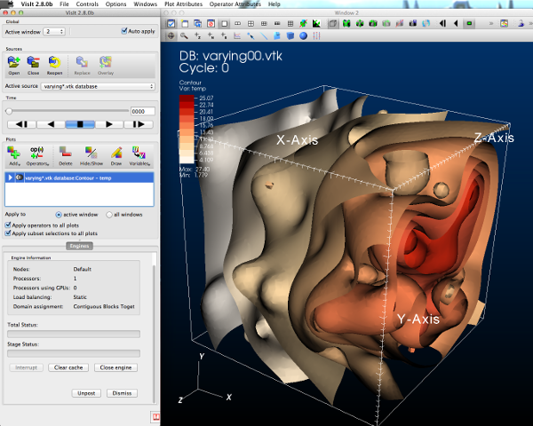

Reader
Filter
Algorithm
Filter
Simulation
Filter
Rendering

Slide 16
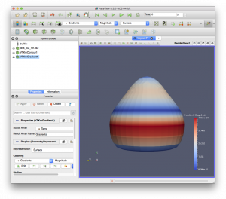
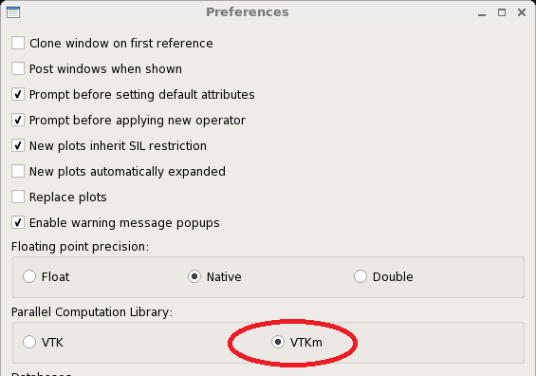
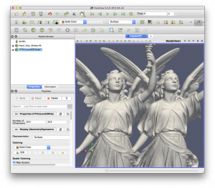

ParaView Plugin for VTK-m
VisIt support for VTK-m
Selecting VTK-m with preferences window
Contour plot w/VTK and w/VTK-m

Slide 17
How Do I Use VTK-m?
I develop software that uses (or will use) visualization libraries.

Slide 18
Reader
Filter
Algorithm
Filter
VTK/Accelerators/Vtkm
Simulation
Filter
Rendering

Slide 19
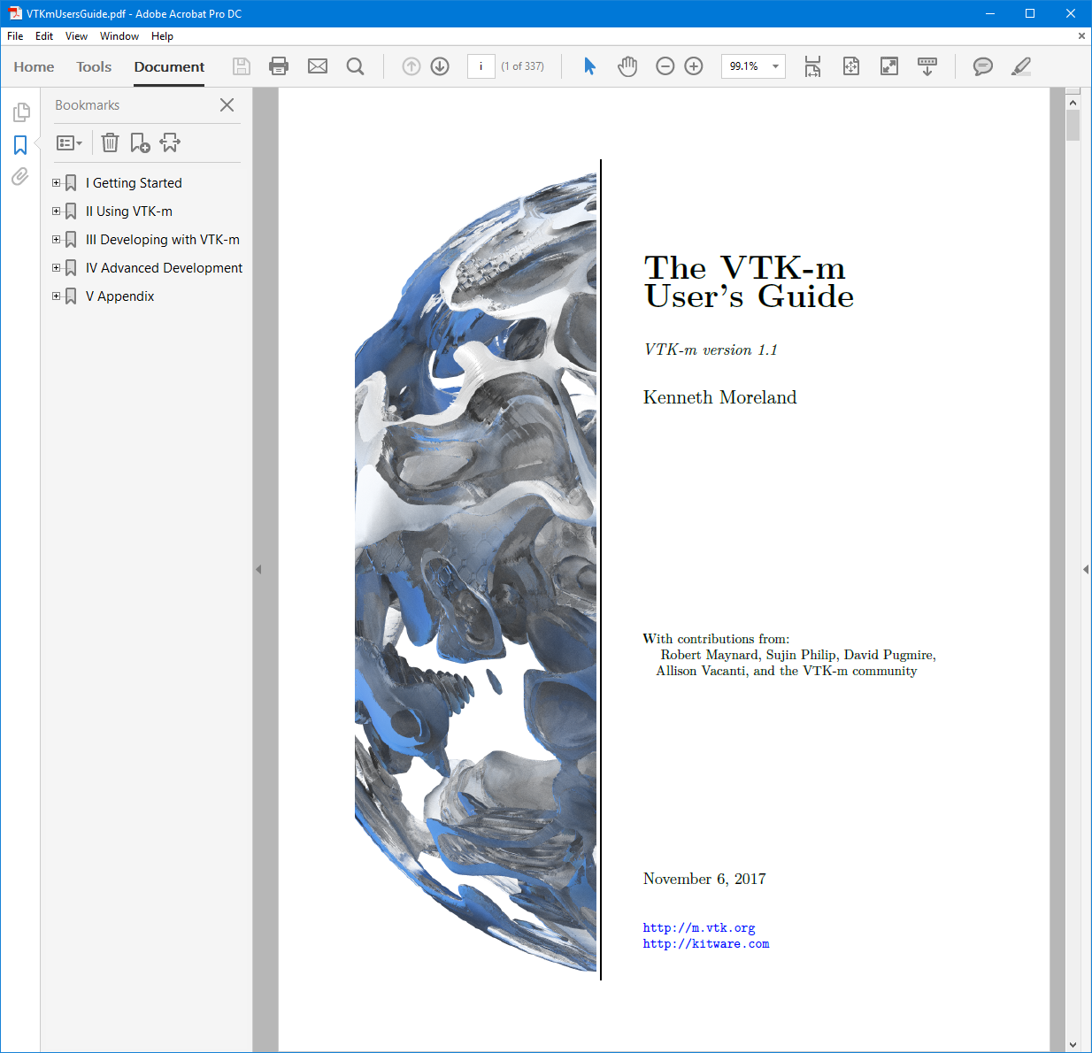

Slide 20
How Do I Use VTK-m?
I develop visualization software and want to make the leap to many-core devices.

Slide 22
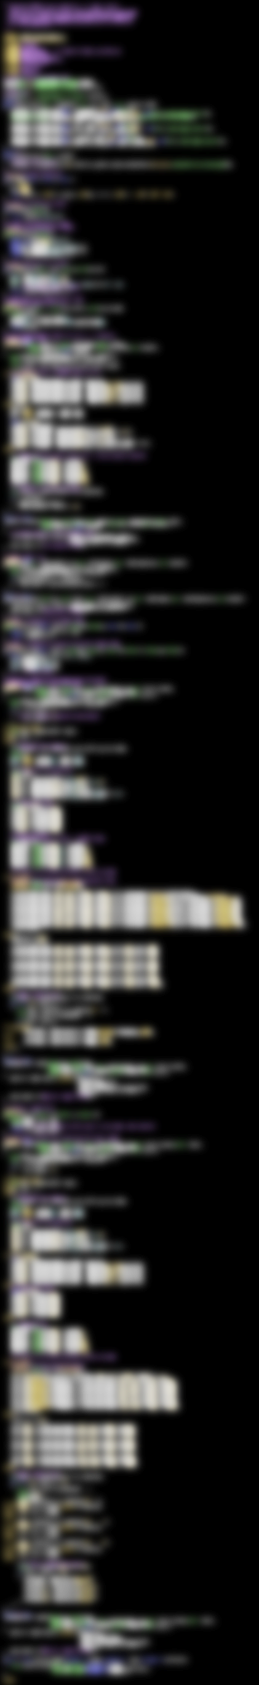

VTK-m
283 Lines
CUDA SDK
561 Lines
Notes:
The source code of Marching Cubes in three different packages. Case tables removed (all essentially the same).
CUDA SDK: marchingCubes_kernel.cu
VTK-m: IsosurfaceUniformGrid.h

Slide 23
Summary
Many-core processing is coming to… everything
VTK-m is coming to use them efficiently

